Slide 1
CAPSTONE PROJECT
ON
EMPLOYEE MANAGEMENT SYSTEM
BATCH-8
JAVA J2EE
By Saragadam Vara Sai Ram

Slide 2
Introduction
The Employee Management System is a distributed application designed to manage employee-related information within an organization efficiently. The system allows administrators to manage employees, departments, tasks, and performance evaluations. The architecture of the system is based on microservices, which ensures scalability and flexibility, enabling the organization to adapt and grow as needed.

Slide 3
Technologies Used
Java: Core programming language used for application development.
Spring Boot: Framework that simplifies the creation of production-ready Spring applications, allowing for easy setup and rapid deployment.
Spring Cloud: Handles cross-cutting concerns like configuration management, service discovery, circuit breakers, and distributed tracing, enabling microservices architecture.
Spring Data JPA: Simplifies data access and provides a standard API for database interactions.
MySQL DB: The relational database management system used for storing the application's data.
RESTful APIs: The architectural style used for designing networked applications and providing communication between different microservices.
JUnit: A testing framework used for unit testing the application’s components, ensuring code quality and reliability.

Slide 4
Problem Statement
The primary goal of this project is to create a robust Employee Management System that caters to the following requirements.
For Admins:
A centralized system to manage employees, departments, and roles.
CRUD (Create, Read, Update, Delete) operations on employee records.
Assignment of roles to employees and organizing them into departments.
Management of tasks and performance evaluations.
For Employees:
Ability to manage personal profiles.
View assigned tasks and update task statuses.
Track performance and receive feedback from managers.

Slide 5
Microservices Architecture
Eureka Server
Api-Gateway
Employee-Capstone
Authentication
Department-Capstone
Performance-Capstone
Task-Capstone

Slide 6
Microservices Architecture
Microservices architecture breaks down the application into small, independent services, each responsible for specific business functionalities. These services communicate through APIs, allowing for greater flexibility, scalability, and maintainability.
Service Registry & Discovery
Eureka Server
Role: Eureka acts as a service registry, allowing microservices to register themselves at runtime. This enables dynamic discovery and communication between services.
Functionality: Helps services discover and communicate with one another efficiently, enabling scalability.
API Gateway
Spring Cloud Gateway
Role: Serves as the single entry point for all client requests.
Functionality: Routes requests to appropriate backend services and handles cross-cutting concerns like authentication, logging, and rate limiting.

Slide 7
Authentication Service
User Authentication & Authorization: Manages user login, registration, and role-based access control.
JWT (JSON Web Token): Used for secure communication between the client and server, ensuring that only authenticated users can access certain parts of the system.
Employee Management Microservice
Employee Directory: Manages employee records, including personal details, job roles, and department assignments.
Functionality: Provides APIs for CRUD operations on employee data, enabling efficient management of the workforce.
Department Management Microservice
Department Catalog: Manages department-specific data, including the organization of employees within departments.
Functionality: Offers APIs for managing departments, including creating, updating, and deleting departments.

Slide 8
Task Management Microservice
Task Assignment: Handles the creation and assignment of tasks to employees.
Functionality: Provides APIs for task management, including tracking progress, updating task details, and marking tasks as complete.
Performance Management Microservice
Employee Performance Tracking: Tracks and evaluates employee performance based on task completion and other metrics.
Functionality: Offers features for performance reviews, feedback provision, and generating evaluation reports to support HR decisions.

Slide 9
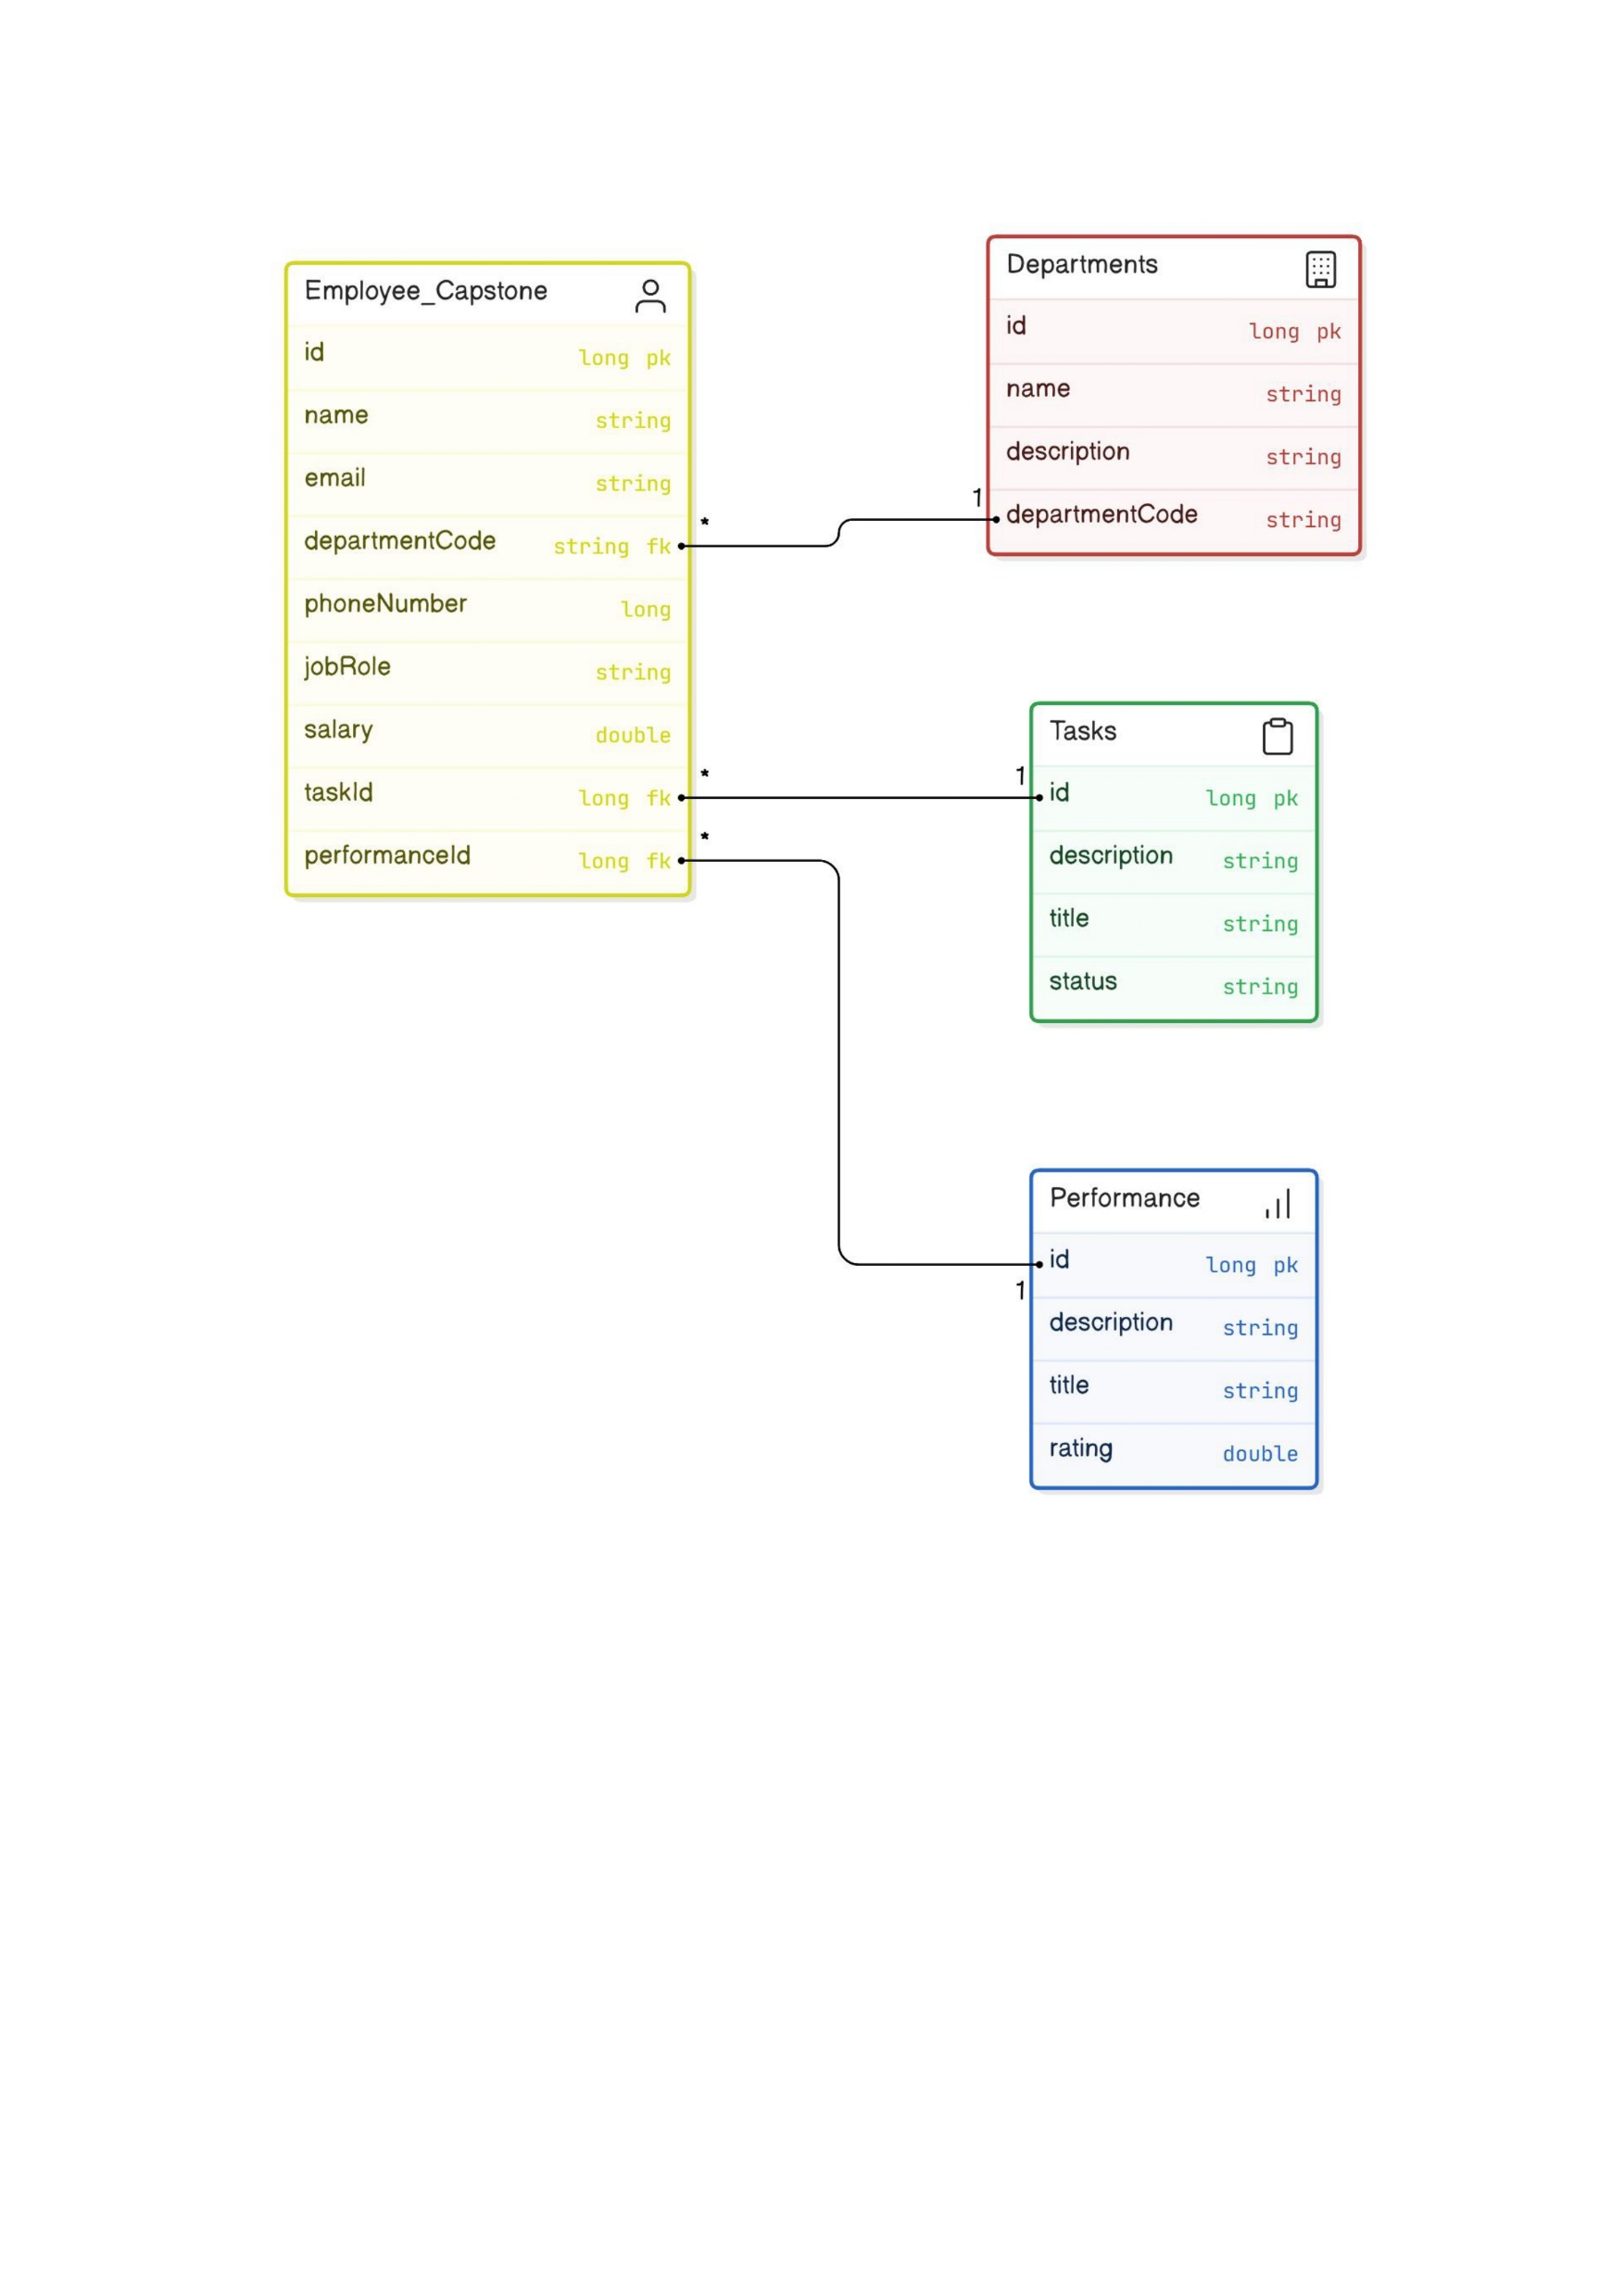
Flowchart of EMS

Slide 10
Project Flow
Admin Module
Admin Dashboard
Role: Acts as the centralized interface for Admins to manage the organization.
Features: Provides analytics, reports on employee performance, and departmental efficiency.
Employee Management
Role: Enables Admins to perform CRUD operations on employee records.
Features: Role assignment, department organization, and employee record management.
Department Management
Role: Allows Admins to manage departments by creating, viewing, editing, or deleting department records.
Features: Organizes employees within departments and manages departmental data.

Slide 11
Task Management
Role: Enables Admins to create and assign tasks to employees, monitor progress, and update task statuses.
Features: Task tracking and monitoring of completion rates and deadlines.
Performance Management
Role: Allows Admins to track and evaluate employee performance.
Features: Performance reviews, feedback provision, and generation of evaluation reports.
Employee Module
Employee Registration & Authentication
Role: Manages employee registration and login processes, ensuring secure access to the system.
Features: Profile management, access to assigned roles and departments.

Slide 12
Task Management
Role: Enables employees to view and manage assigned tasks.
Features: Task progress tracking and workload management.
Performance Tracking
Role: Allows employees to view performance metrics and feedback.
Features: Participation in performance reviews and tracking career development goals.

Slide 13
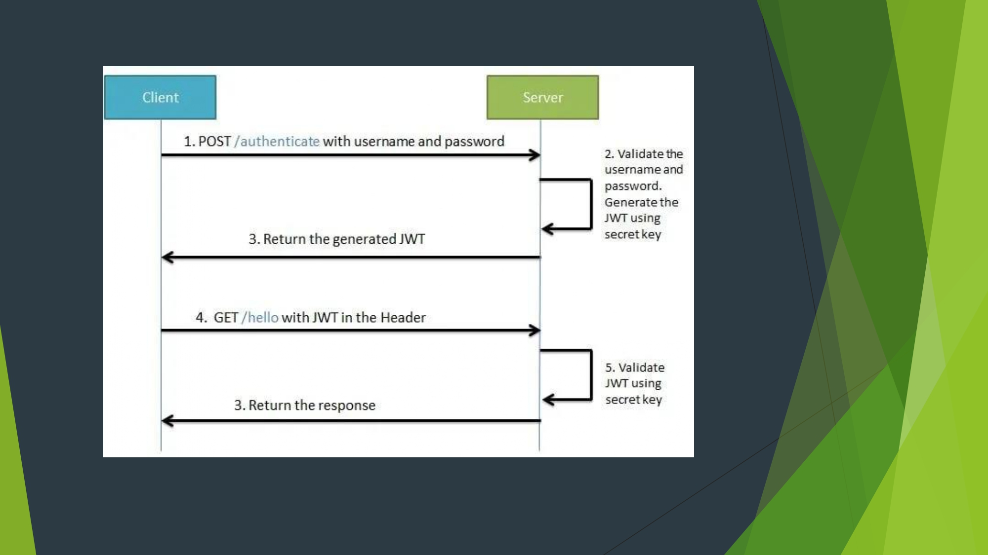
Fig: Client-Server Connection

Slide 14
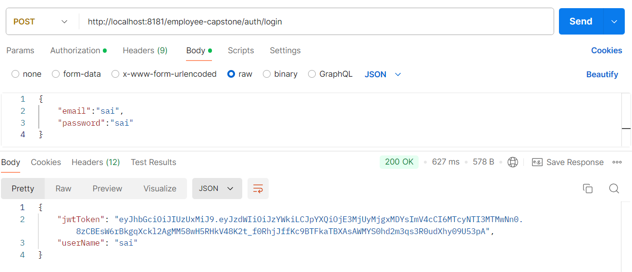
Fig: Authentication

Slide 15
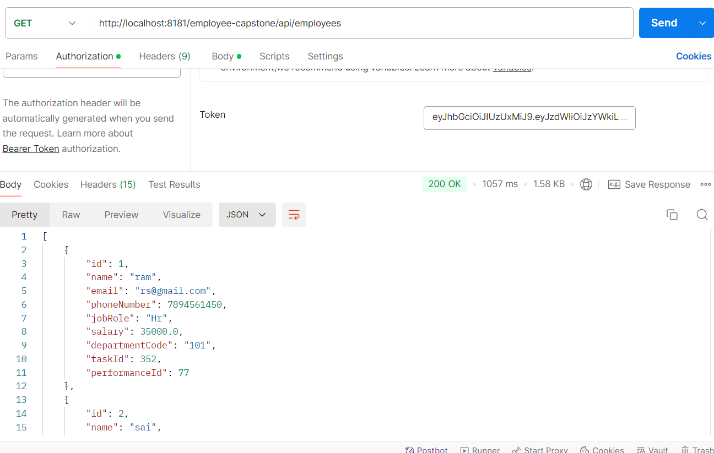
Fig: Fetching Employee Data With JWT Token

Slide 16
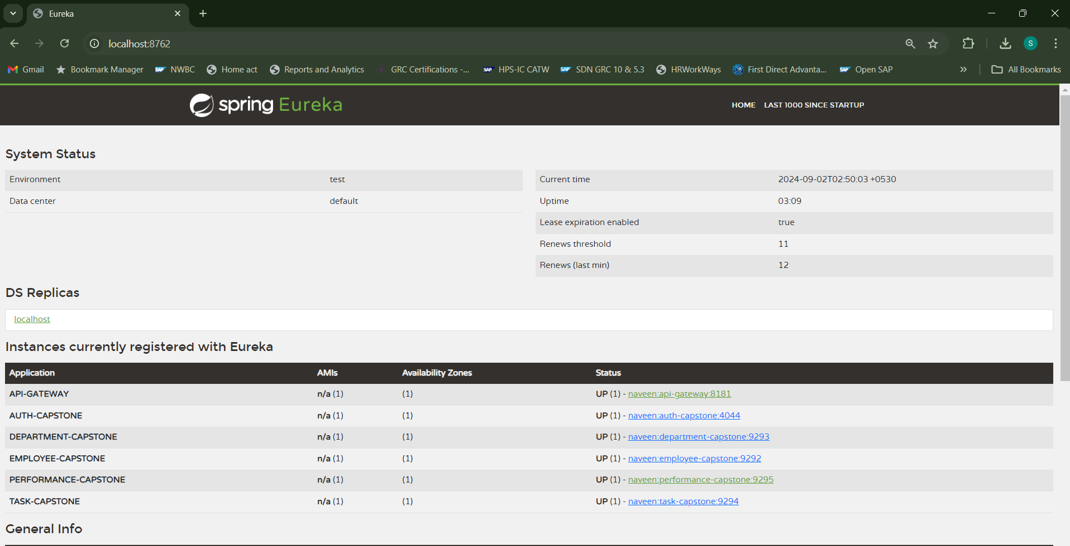
Fig: Spring Eureka Server

Slide 17
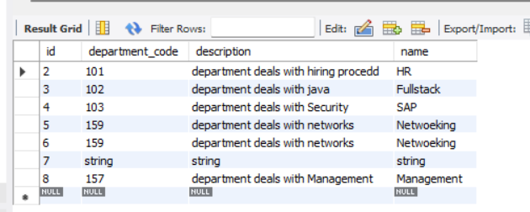
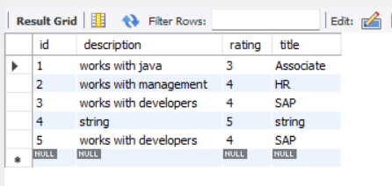
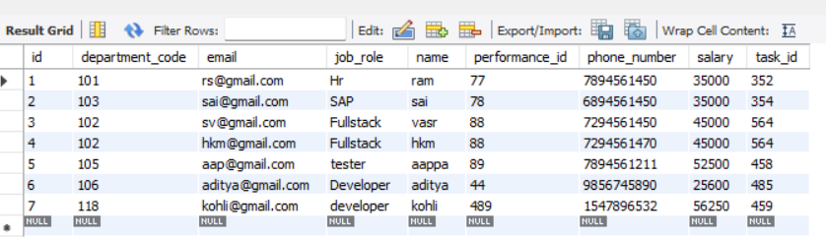
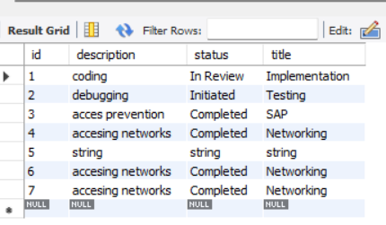
Fig: Tables in MySQL Data Base

Slide 18
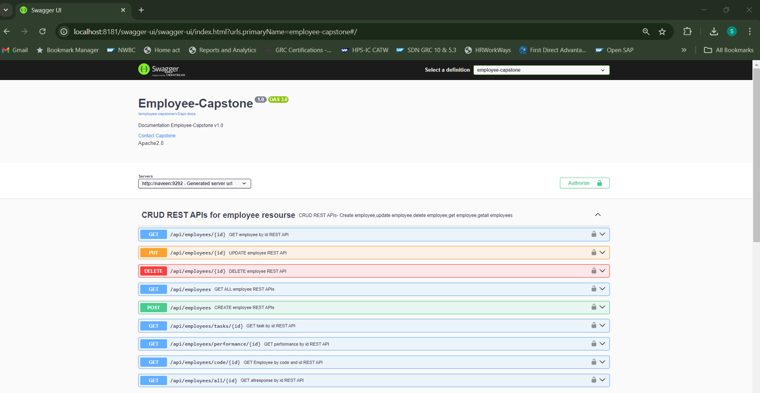
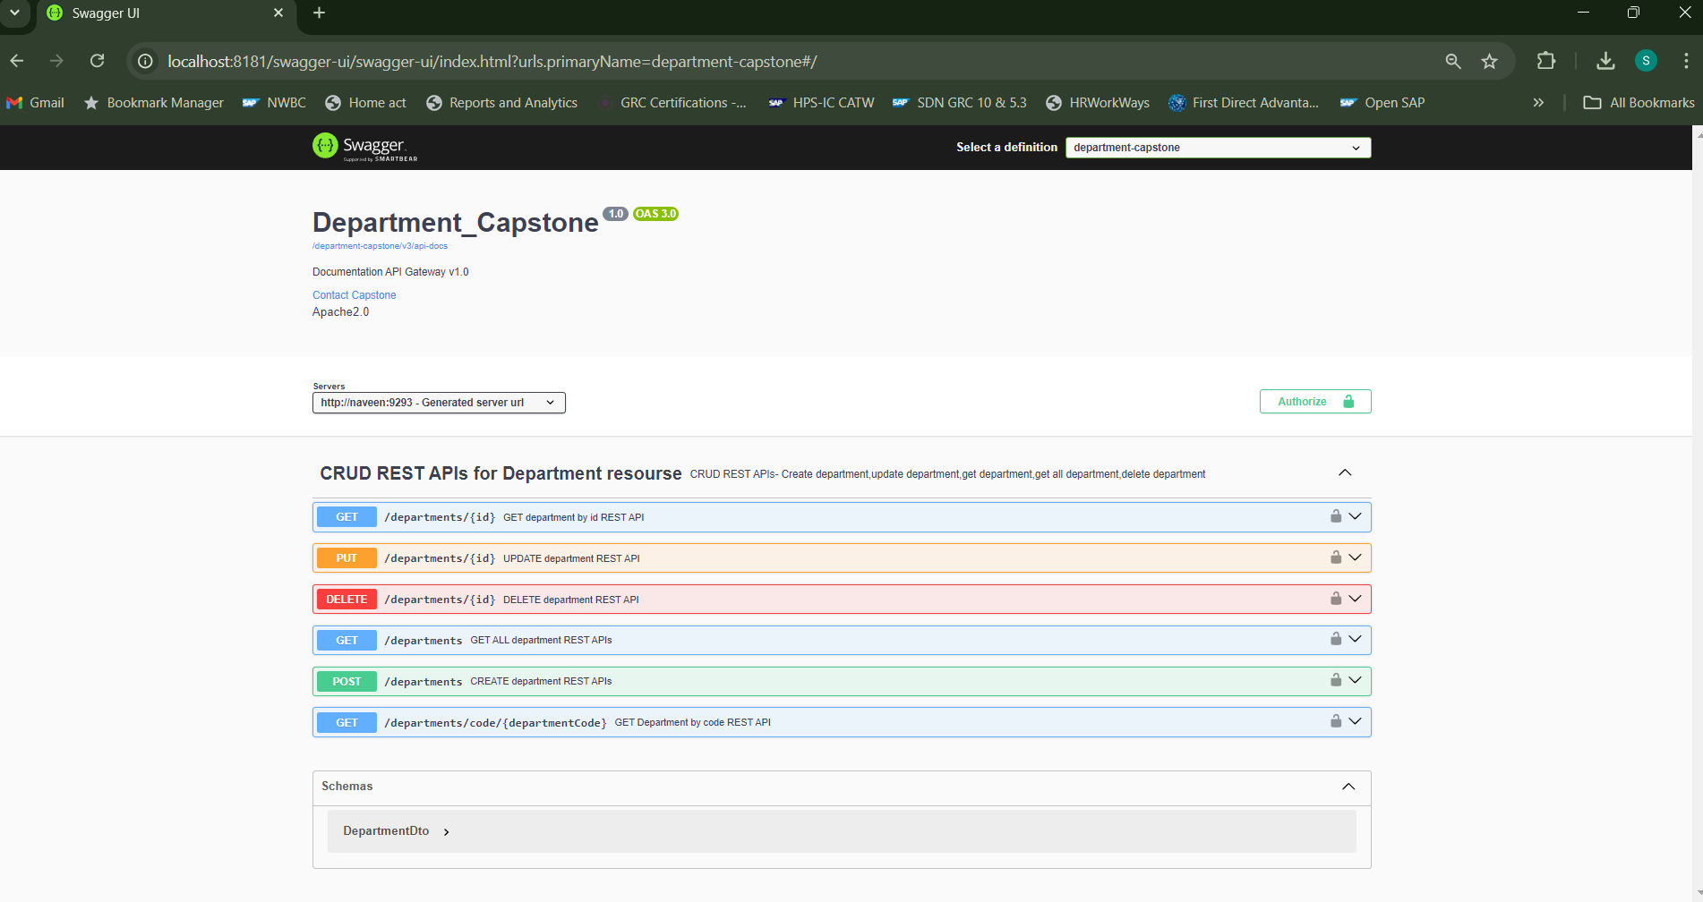
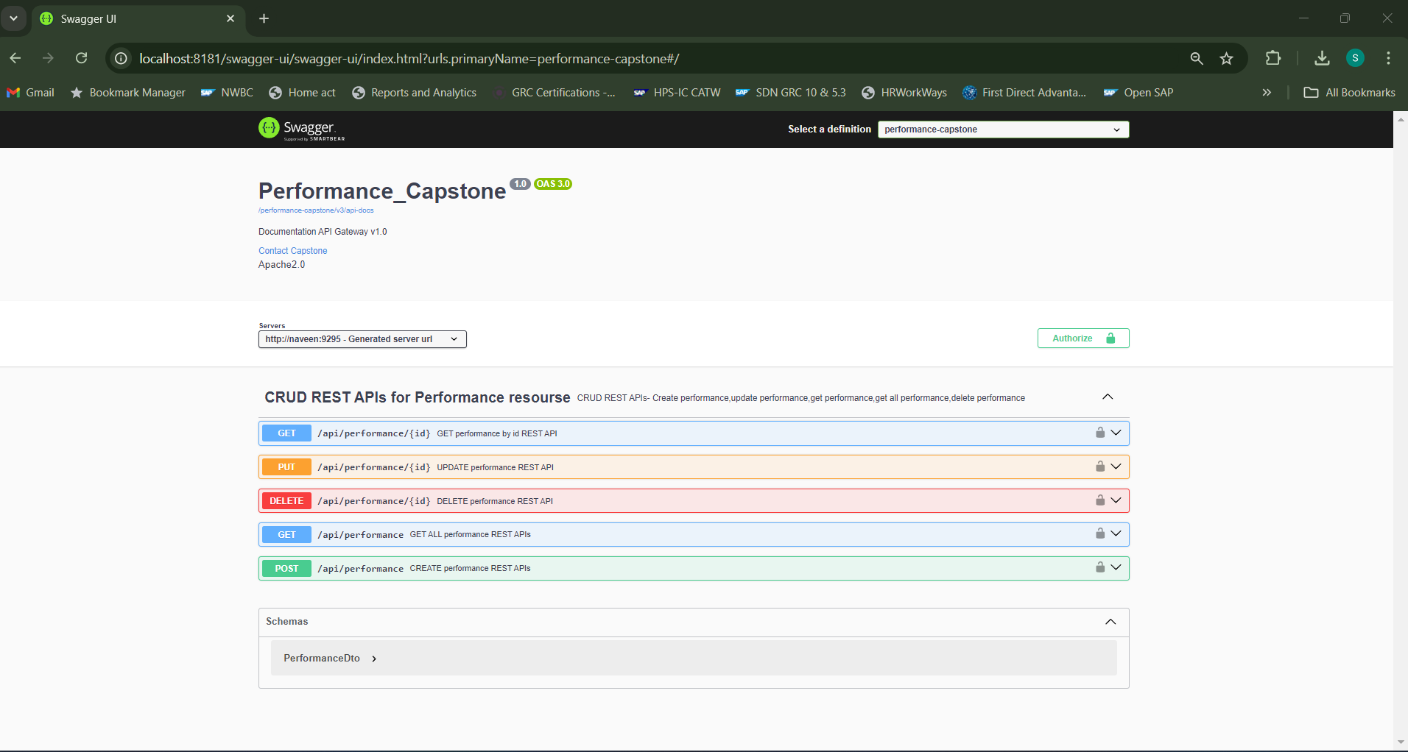
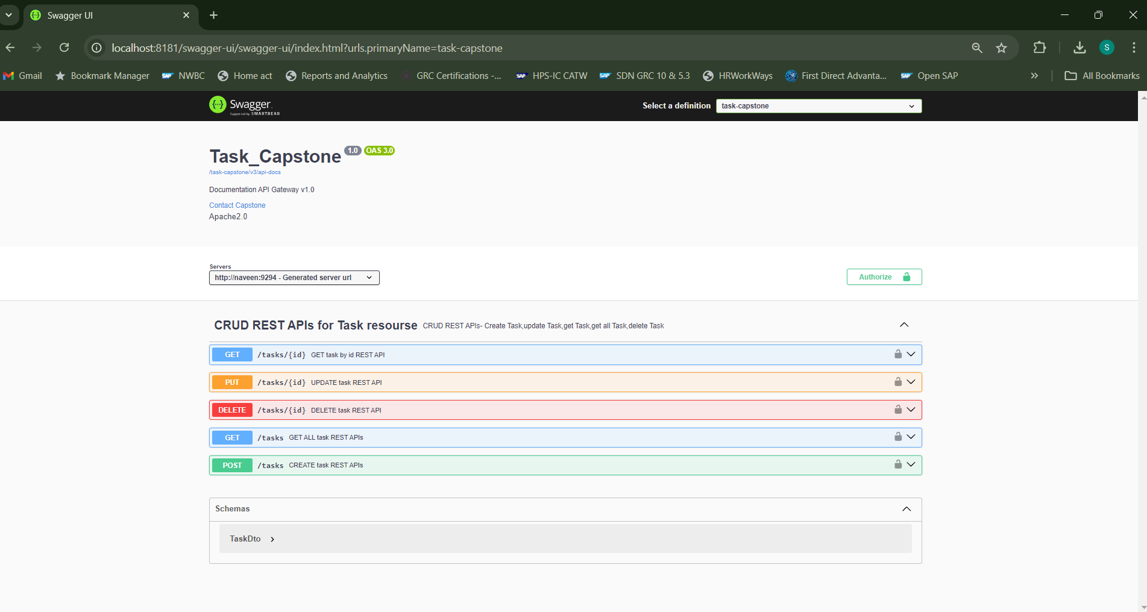
Fig: Swagger UI

Slide 19
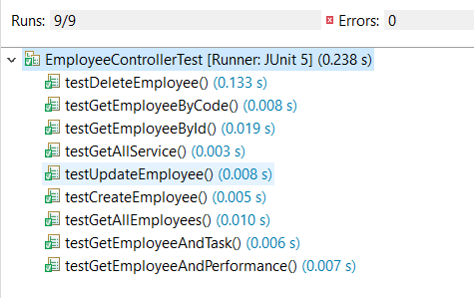
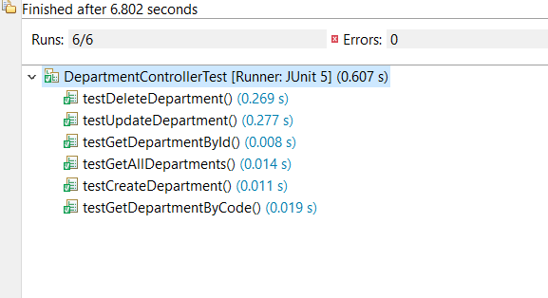
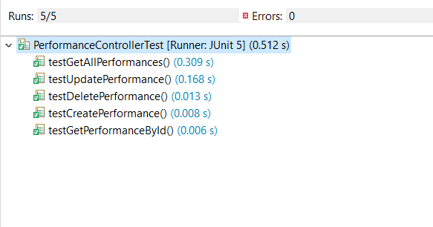
Junit Testing:
Each microservice was tested independently using JUnit and Mockito.

Slide 20
Conclusion
Summary:
The Employee Management System project effectively showcases the advantages of using a microservices architecture for scalability and modularity. By utilizing Java, Spring Boot, Spring Cloud, and MySQL/MariaDB, the system efficiently manages employees, departments, tasks, and performance evaluations. It provides secure access via JWT-based authentication, ensuring data integrity and confidentiality. This system lays a solid foundation for further enhancements, including advanced analytics, mobile integration, and machine learning, making it a robust solution for modern human resource management.
Future Enhancements:
Advanced Analytics: Integrate advanced analytics for deeper insights into employee performance and organizational efficiency.
Mobile Access: Develop mobile applications for enhanced accessibility and a better user experience.
Machine Learning: Implement predictive analytics to forecast employee performance trends.
HR System Integration: Connect with payroll, attendance, and other HR systems for comprehensive management.
Real-Time Notifications: Add real-time notifications for task updates and performance feedback.

Slide 21
THANK YOU

